Slide 1



Notes:
Hello, in this presentation we will enhance the model we saw in the previous topic using story interleaving.

Slide 2

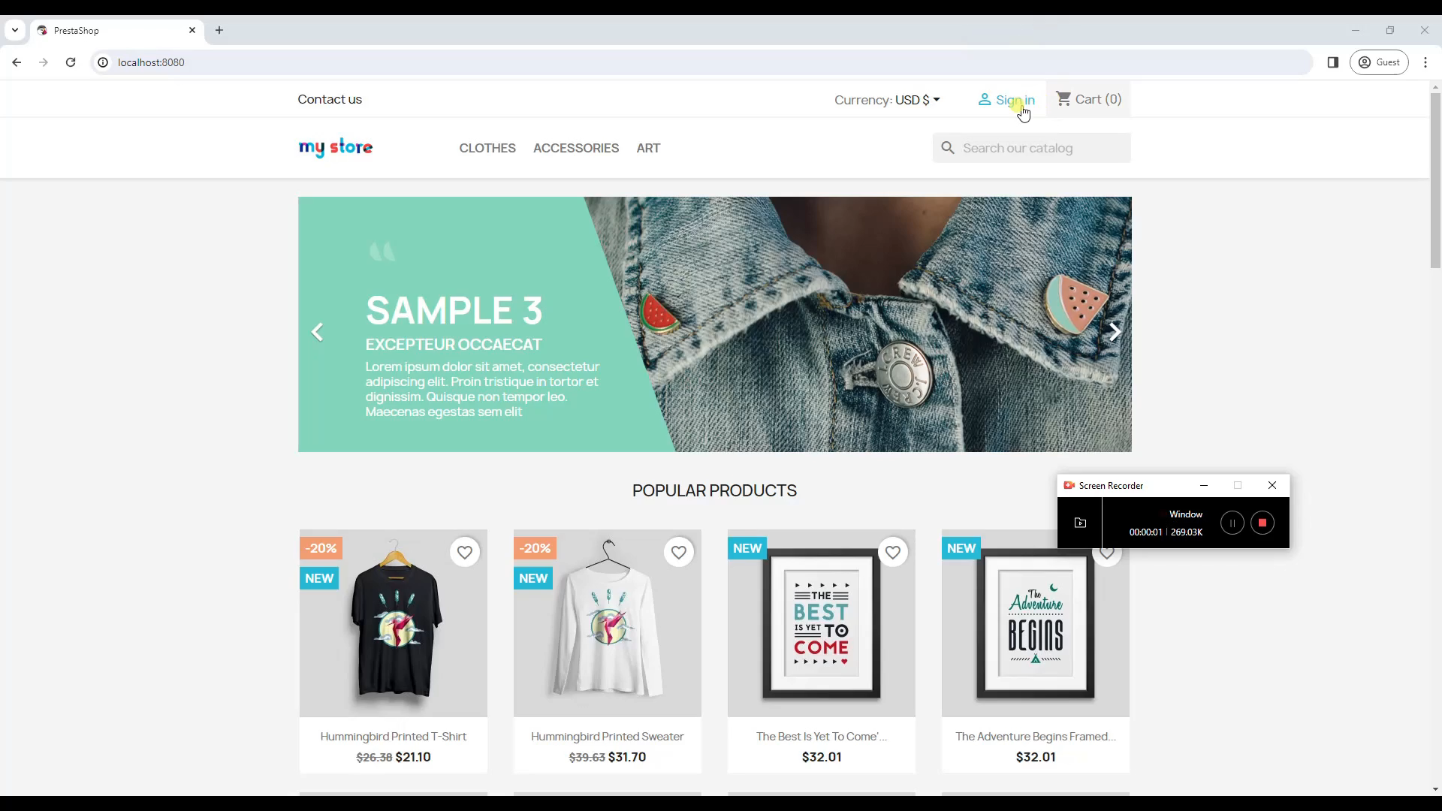
bthread("", function () {
sync({ request: Event('AddProductToCart', { name: 'HUMMINGBIRD PRINTED T-SHIRT' }) })
sync({ request: Event('Login', { email: 'bob.marley@provego.com', password: 'ishotthesherif' }) })
sync({ request: Event('AddProductToCart', { name: 'HUMMINGBIRD PRINTED T-SHIRT' }) })
sync({ request: Event('AddProductToCart', { name: 'HUMMINGBIRD PRINTED SWEATER' }) })
sync({ request: Event('Checkuout', { defaultAdress: true, defaultPaymentMethod: true }) })
})
Notes:
As illustrated in the exercise from the preceding topic, the online shop allows to add products to the shopping cart prior to user login. This suggests that a tester might consider enhancing the test’s diversity by providing the option for the user to login at any point during the test.

Slide 3
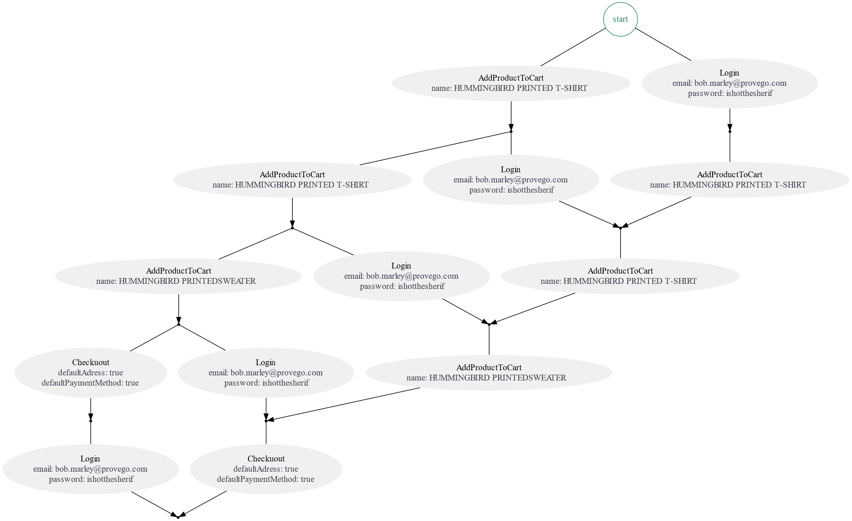
bthread(“Shop", function () {
sync({ request: Event('AddProductToCart', { name: 'HUMMINGBIRD PRINTED T-SHIRT' }) })
sync({ request: Event('AddProductToCart', { name: 'HUMMINGBIRD PRINTED T-SHIRT' }) })
sync({ request: Event('AddProductToCart', { name: 'HUMMINGBIRD PRINTED SWEATER' }) })
sync({ request: Event('Checkuout', { defaultAdress: true, defaultPaymentMethod: true }) })
})
bthread(“Login", function () {
sync({ request: Event('Login', { email: 'bob.marley@provego.com', password: 'ishotthesherif' }) })
})
Notes:
In Provengo, this can be achieved through story interleaving. The ‘Shop’ behavioral thread initiates the sequence of events for shopping. Concurrently, the ‘Login’ thread triggers the single event that forms the login sequence. The graph illustrates all potential pathways that emerge from executing these two sequences in parallel.

Slide 4
start
AddProductToCart
Login
name: HUMMINGBIRD PRINTED T-SHIRT
email: bob.marley@provego.com
password: ishotthesherif
AddProductToCart
Login
AddProductToCart
name: HUMMINGBIRD PRINTED T-SHIRT
email: bob.marley@provego.com
name: HUMMINGBIRD PRINTED T-SHIRT
password: ishotthesherif
AddProductToCart
Login
AddProductToCart
name: HUMMINGBIRD PRINTEDSWEATER
email: bob.marley@provego.com
name: HUMMINGBIRD PRINTED T-SHIRT
password: ishotthesherif
Checkuout
Login
AddProductToCart
defaultAdress: true
email: bob.marley@provego.com
name: HUMMINGBIRD PRINTEDSWEATER
defaultPaymentMethod: true
password: ishotthesherif
Login
Checkuout
email: bob.marley@provego.com
defaultAdress: true
password: ishotthesherif
defaultPaymentMethod: true
Notes:
Let’s examine this graph in greater detail:

Slide 5
start
AddProductToCart
Login
name: HUMMINGBIRD PRINTED T-SHIRT
email: bob.marley@provego.com
password: ishotthesherif
AddProductToCart
Login
AddProductToCart
name: HUMMINGBIRD PRINTED T-SHIRT
email: bob.marley@provego.com
name: HUMMINGBIRD PRINTED T-SHIRT
password: ishotthesherif
AddProductToCart
Login
AddProductToCart
name: HUMMINGBIRD PRINTEDSWEATER
email: bob.marley@provego.com
name: HUMMINGBIRD PRINTED T-SHIRT
password: ishotthesherif
Checkuout
Login
AddProductToCart
defaultAdress: true
email: bob.marley@provego.com
name: HUMMINGBIRD PRINTEDSWEATER
defaultPaymentMethod: true
password: ishotthesherif
Login
Checkuout
email: bob.marley@provego.com
defaultAdress: true
password: ishotthesherif
defaultPaymentMethod: true
Notes:
At the initial state, we have two options: log in now or add a t-shirt to the cart.

Slide 6
start
AddProductToCart
Login
name: HUMMINGBIRD PRINTED T-SHIRT
email: bob.marley@provego.com
password: ishotthesherif
AddProductToCart
Login
AddProductToCart
name: HUMMINGBIRD PRINTED T-SHIRT
email: bob.marley@provego.com
name: HUMMINGBIRD PRINTED T-SHIRT
password: ishotthesherif
AddProductToCart
Login
AddProductToCart
name: HUMMINGBIRD PRINTEDSWEATER
email: bob.marley@provego.com
name: HUMMINGBIRD PRINTED T-SHIRT
password: ishotthesherif
Checkuout
Login
AddProductToCart
defaultAdress: true
email: bob.marley@provego.com
name: HUMMINGBIRD PRINTEDSWEATER
defaultPaymentMethod: true
password: ishotthesherif
Login
Checkuout
email: bob.marley@provego.com
defaultAdress: true
password: ishotthesherif
defaultPaymentMethod: true
Notes:
Say, we choose to add a t-shirt to the shopping cart.

Slide 7
start
AddProductToCart
Login
name: HUMMINGBIRD PRINTED T-SHIRT
email: bob.marley@provego.com
password: ishotthesherif
AddProductToCart
Login
AddProductToCart
name: HUMMINGBIRD PRINTED T-SHIRT
email: bob.marley@provego.com
name: HUMMINGBIRD PRINTED T-SHIRT
password: ishotthesherif
AddProductToCart
Login
AddProductToCart
name: HUMMINGBIRD PRINTEDSWEATER
email: bob.marley@provego.com
name: HUMMINGBIRD PRINTED T-SHIRT
password: ishotthesherif
Checkuout
Login
AddProductToCart
defaultAdress: true
email: bob.marley@provego.com
name: HUMMINGBIRD PRINTEDSWEATER
defaultPaymentMethod: true
password: ishotthesherif
Login
Checkuout
email: bob.marley@provego.com
defaultAdress: true
password: ishotthesherif
defaultPaymentMethod: true
Notes:
We are now at a state where, again, we can log in or add a t-shirt to the shopping cart.

Slide 8
start
AddProductToCart
Login
name: HUMMINGBIRD PRINTED T-SHIRT
email: bob.marley@provego.com
password: ishotthesherif
AddProductToCart
Login
AddProductToCart
name: HUMMINGBIRD PRINTED T-SHIRT
email: bob.marley@provego.com
name: HUMMINGBIRD PRINTED T-SHIRT
password: ishotthesherif
AddProductToCart
Login
AddProductToCart
name: HUMMINGBIRD PRINTEDSWEATER
email: bob.marley@provego.com
name: HUMMINGBIRD PRINTED T-SHIRT
password: ishotthesherif
Checkuout
Login
AddProductToCart
defaultAdress: true
email: bob.marley@provego.com
name: HUMMINGBIRD PRINTEDSWEATER
defaultPaymentMethod: true
password: ishotthesherif
Login
Checkuout
email: bob.marley@provego.com
defaultAdress: true
password: ishotthesherif
defaultPaymentMethod: true
Notes:
Now, we may opt to proceed with the Login.

Slide 9
start
AddProductToCart
Login
name: HUMMINGBIRD PRINTED T-SHIRT
email: bob.marley@provego.com
password: ishotthesherif
AddProductToCart
Login
AddProductToCart
name: HUMMINGBIRD PRINTED T-SHIRT
email: bob.marley@provego.com
name: HUMMINGBIRD PRINTED T-SHIRT
password: ishotthesherif
AddProductToCart
Login
AddProductToCart
name: HUMMINGBIRD PRINTEDSWEATER
email: bob.marley@provego.com
name: HUMMINGBIRD PRINTED T-SHIRT
password: ishotthesherif
Checkuout
Login
AddProductToCart
defaultAdress: true
email: bob.marley@provego.com
name: HUMMINGBIRD PRINTEDSWEATER
defaultPaymentMethod: true
password: ishotthesherif
Login
Checkuout
email: bob.marley@provego.com
defaultAdress: true
password: ishotthesherif
defaultPaymentMethod: true
Notes:
In THIS state, we don’t have a choice. We must add another T-Shirt to the shopping cart.

Slide 10
start
AddProductToCart
Login
name: HUMMINGBIRD PRINTED T-SHIRT
email: bob.marley@provego.com
password: ishotthesherif
AddProductToCart
Login
AddProductToCart
name: HUMMINGBIRD PRINTED T-SHIRT
email: bob.marley@provego.com
name: HUMMINGBIRD PRINTED T-SHIRT
password: ishotthesherif
AddProductToCart
Login
AddProductToCart
name: HUMMINGBIRD PRINTEDSWEATER
email: bob.marley@provego.com
name: HUMMINGBIRD PRINTED T-SHIRT
password: ishotthesherif
Checkuout
Login
AddProductToCart
defaultAdress: true
email: bob.marley@provego.com
name: HUMMINGBIRD PRINTEDSWEATER
defaultPaymentMethod: true
password: ishotthesherif
Login
Checkuout
email: bob.marley@provego.com
defaultAdress: true
password: ishotthesherif
defaultPaymentMethod: true
Notes:
This goes on until we reach the bottom node of the graph, giving us a full test path.

Slide 11
start
AddProductToCart
Login
name: HUMMINGBIRD PRINTED T-SHIRT
email: bob.marley@provego.com
password: ishotthesherif
AddProductToCart
Login
AddProductToCart
name: HUMMINGBIRD PRINTED T-SHIRT
email: bob.marley@provego.com
name: HUMMINGBIRD PRINTED T-SHIRT
password: ishotthesherif
AddProductToCart
Login
AddProductToCart
name: HUMMINGBIRD PRINTEDSWEATER
email: bob.marley@provego.com
name: HUMMINGBIRD PRINTED T-SHIRT
password: ishotthesherif
Checkuout
Login
AddProductToCart
defaultAdress: true
email: bob.marley@provego.com
name: HUMMINGBIRD PRINTEDSWEATER
defaultPaymentMethod: true
password: ishotthesherif
Login
Checkuout
email: bob.marley@provego.com
defaultAdress: true
password: ishotthesherif
defaultPaymentMethod: true
Notes:
More generally, the state graph represents all the test paths that our model specifies. The small dots are the states of the model, and the larger ovals with text are the events the model triggers to advance the states. For example, the graph here contains ten states representing a model with five test paths.

Slide 12
Notes:
This brings our presentation to a close. We’ve seen the concept of story-interleaving in Provengo and how it is shown on the state graph.

